Slide 1


SIMPLE 3D: MID-SEMESTER
PROJECT REVIEW
Group 17.
Team:
  Sahil
  Samarth
  Shubham
  Pranjali
-Guided by Prof. Varsha Jadhav

Slide 2
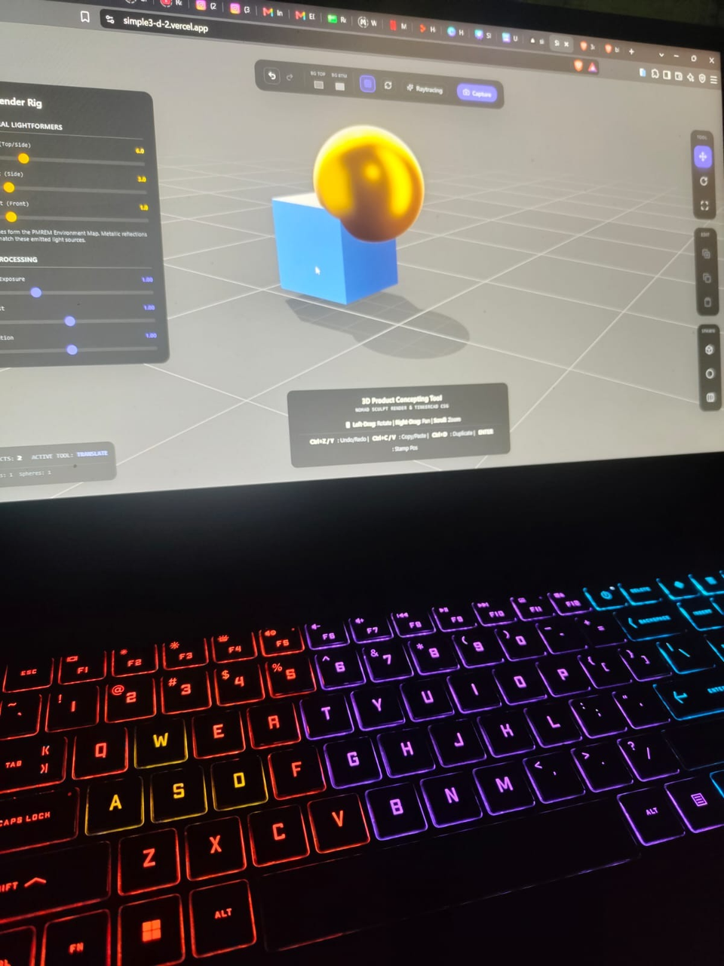
SIMPLE 3D: HIGH-END 3D, MADE SIMPLE
Core Objective: POC
Engineering Feat
What is Simple 3D?
  Prove high-fidelity 3D rendering in the browser
  Combine professional visuals with beginner-friendly controls
  Target: Blender/Nomad-level fidelity + Tinkercad-level ease
  Real-time, client-side rendering
  Stable and performant web-based 3D engine
  Professional-grade graphics without installation
  Zero-install, browser-based 3D workspace
  Designed for easy and accessible 3D creation

Slide 3
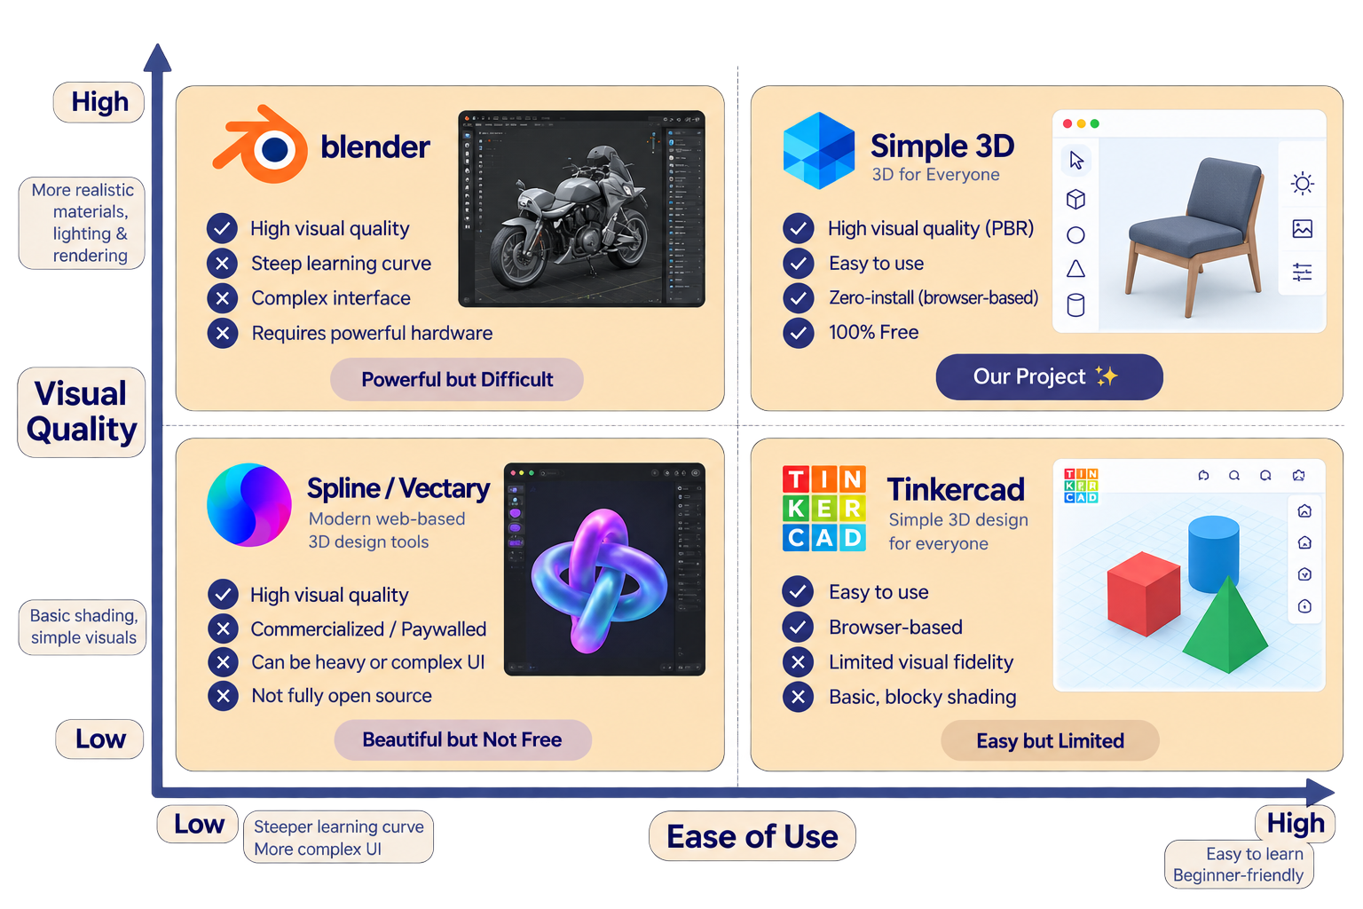
THE PROBLEM: A GAP IN 3D CREATION

Slide 4
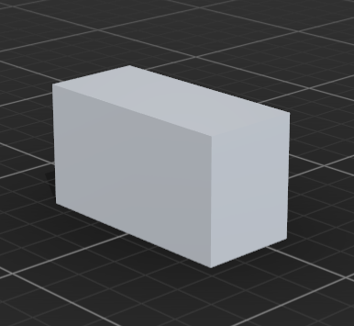
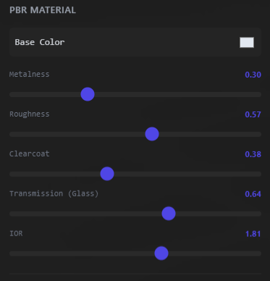
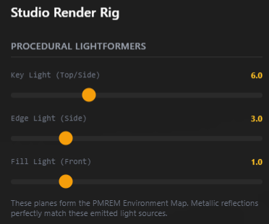
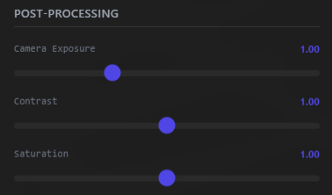
VISUAL PROOF: HIGH-END 3D IN THE BROWSER
The Technical Leap
High-fidelity studio-quality visuals: instantly, client-side.
  PBR materials:
  Metalness • Roughness • Clearcoat
• Transmission
  Real-time reflections & lighting
  Lighting separated from the background
  Runs directly in the web browser

Slide 5
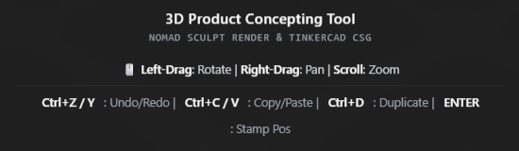
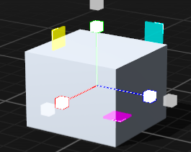
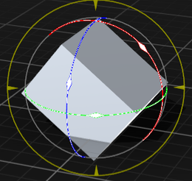
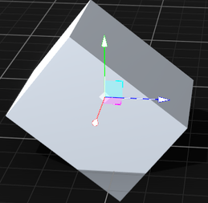
INTERFACE & EXPERIENCE
Effortless Interaction:
  Zero prior 3D knowledge required
  Intuitive drag, scale & rotate controls
Smooth Transformations:
  Continuous state synchronization with onObjectChange
  Smooth, responsive TransformControls
  No snapping or interaction glitches
Minimalist Controls:
  Simple sliders for PBR properties
  Create shiny metal, glass & frosted
materials with ease

Slide 6
FEATURE DEVELOPMENT ROADMAP
Currently Developing
Next Development Goals
  PBR Material System — Real-time metalness, roughness, clearcoat & transmission
  Dynamic Studio Lighting — Key, Edge & Fill with procedural backgrounds
  Smooth Transformations — Real-time, responsive mesh interaction
  CSG Booleans — Real-time cut & combine operations
  Edge Filleting — Client-side geometry refinement
  GLTF / OBJ Export — For 3D printing & external workflows
Goal: Continuously improve performance, stability & visual fidelity.

Slide 7
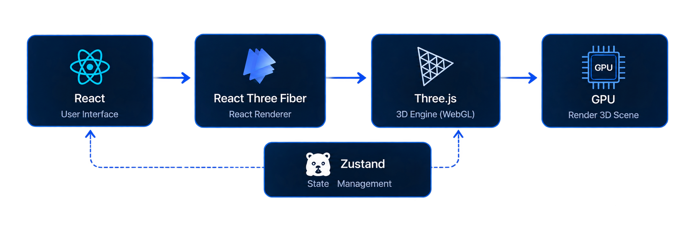
PROJECT ARCHITECTURE: FROM UI TO GPU
ENGINEERING CHALLENGE
  React’s declarative UI ↔ Three.js’s imperative render loop
  Continuous synchronization between UI state & GPU transforms
  Optimized to maintain smooth real-time rendering
  Minimizes unnecessary React re-renders

Slide 8
METHODOLOGY: AGILE DEVELOPMENT
PHASE 1 — FOUNDATION
WebGL + React Integration
Set up the core 3D rendering environment.
PHASE 2 — STATE SYNC
React + Three.js + Zustand
Established reliable real-time state synchronization.
PHASE 3 — CURRENT
PBR + Lighting + Deployment
Refining rendering, lighting, and Vercel CI/CD
PHASE 4 — NEXT
CSG + File I/O
Developing advanced geometry operations and GLTF/OBJ export.

Slide 9
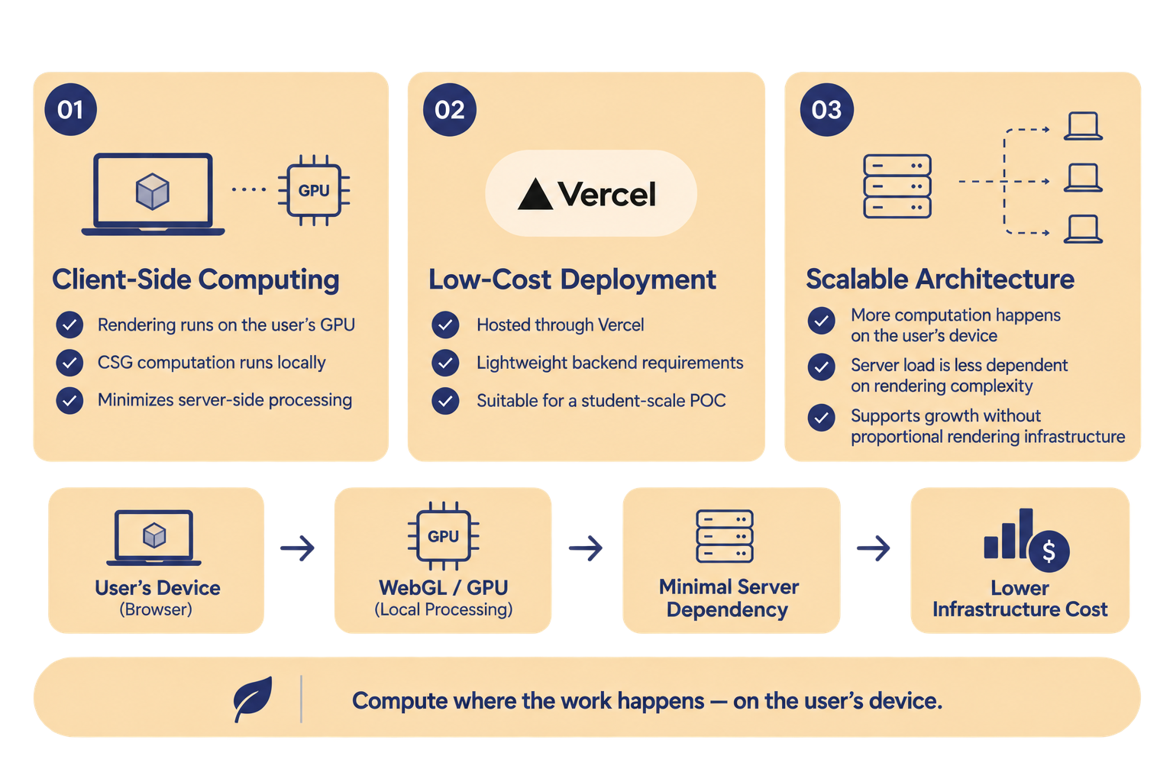
COSTS & SUSTAINABILITY

Slide 10
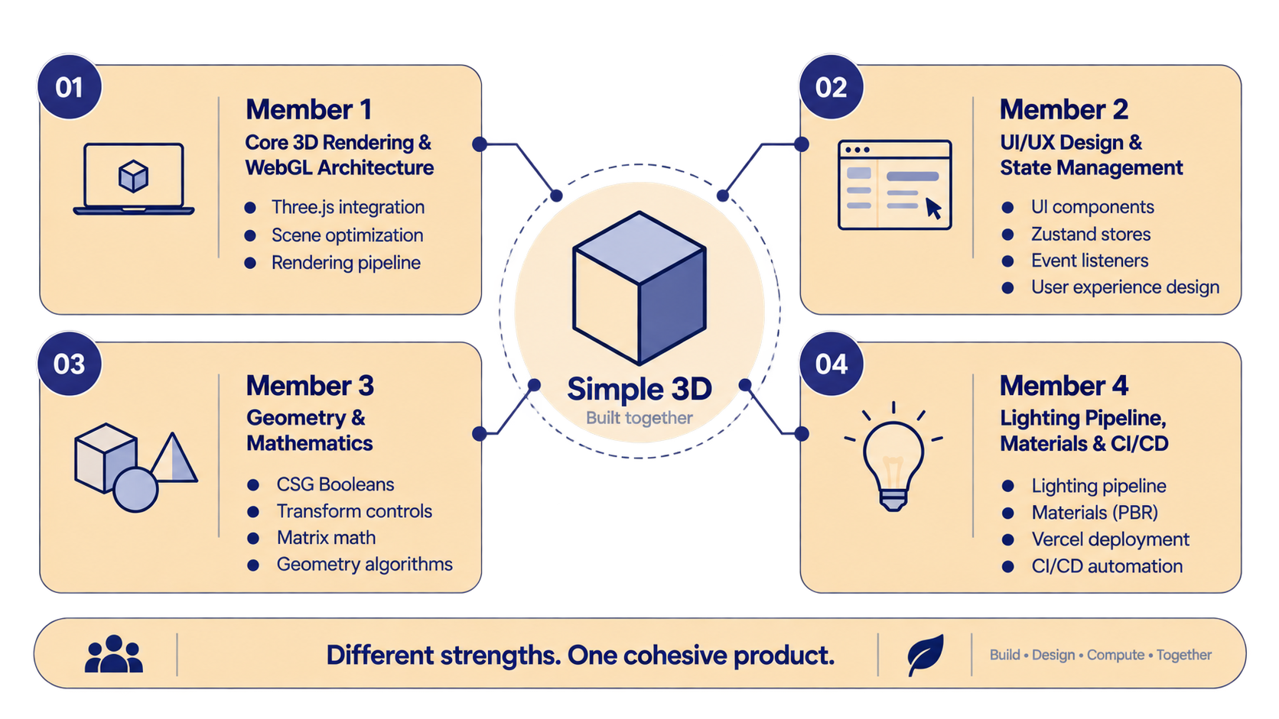
RESPONSIBILITY DISTRIBUTION

Slide 11
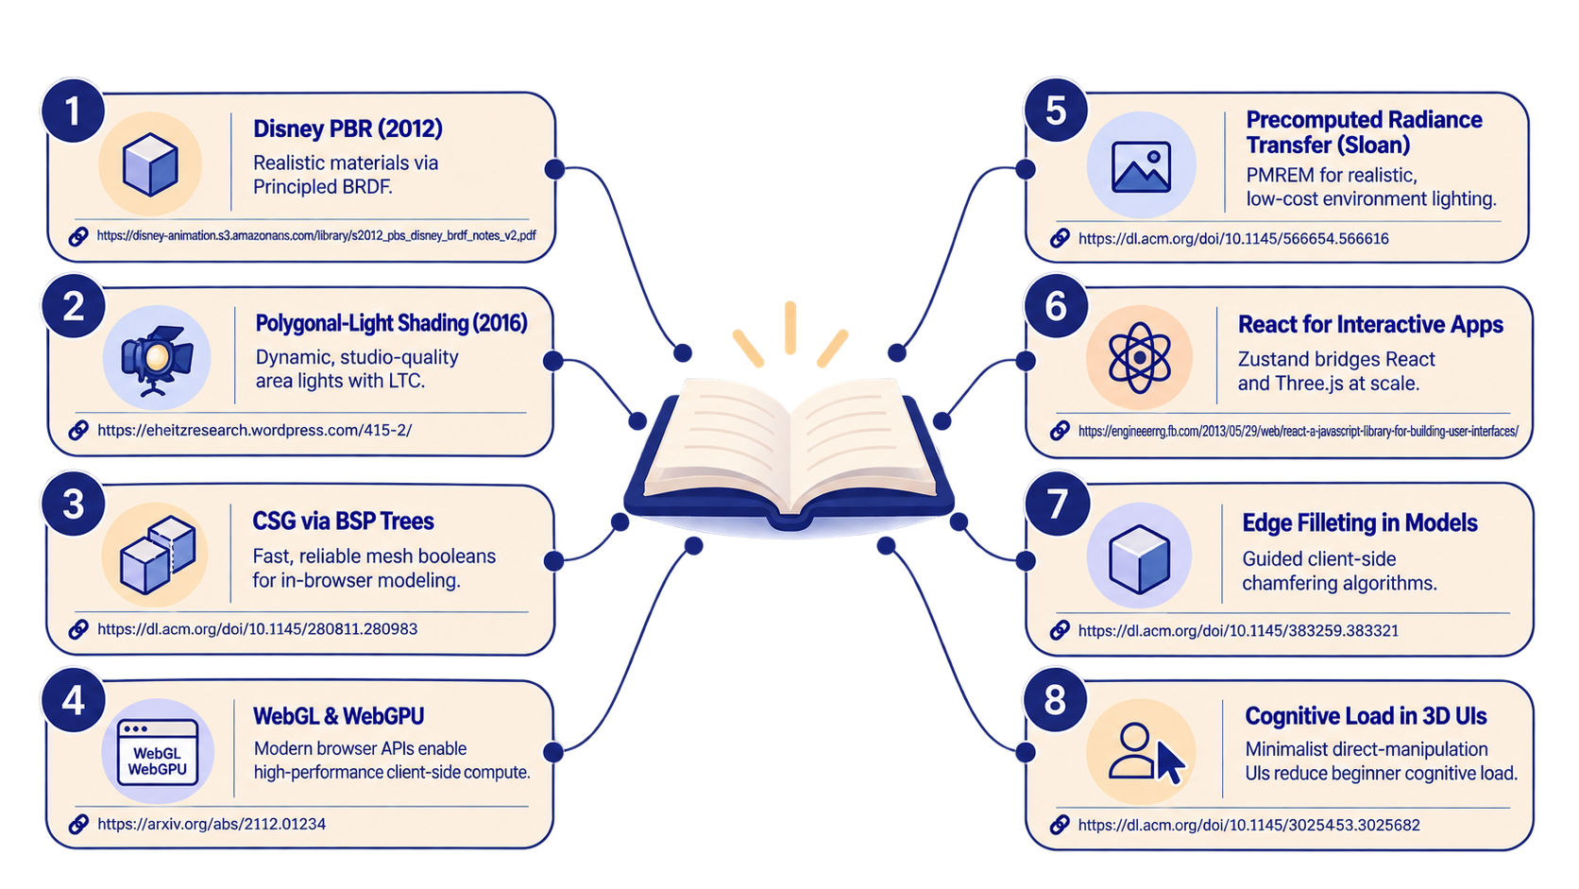
LITERATURE REVIEW & RESEARCH

Slide 12
WHAT COMES NEXT
Simple 3D shows that ease of use and visual quality can coexist combining high-end PBR rendering with a smooth, intuitive browser experience.
  What’s Next
  Smart Dimensions — Precise measurements & modeling
  CSG Booleans — Stable cut & combine operations
  Edge Filleting — Smoother, refined geometry
  File Export — GLTF / OBJ workflows
  Final Thought
  Democratizing high-quality 3D for the next generation of designers, hobbyists & engineer
THANK YOU!

